Slide 1


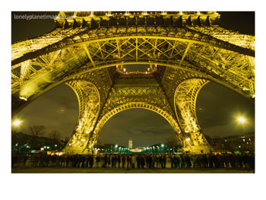
Computer Networks Performance Evaluation

Slide 2
Chapter 14
Queuing Models with Load Dependent Devices
Performance by Design:
Computer Capacity Planning by Example
Daniel A. Menascé, Virgilio A.F. Almeida, Lawrence W. Dowdy
Prentice Hall, 2004

Slide 3
Chapter 14-Outlines
14.1 Introduction
14.2 Motivating Example
14.3 Single Class Models with LD Devices
14.4 Multiclass Closed Models with LD Devices
14.5 Multiclass Open Models with LD Devices
14.6 Flow-Equivalent Server Method
14.7 Concluding Remarks
14.8 Exercises
Bibliography

Slide 4
Introduction
Load-dependent devices (LD) are used to model service centers where the service rate varies with the number of customers present in its queue.
For example, multimedia traffic uses variable grades of service to control congestion.
When a system has a large number of requests queued, new arrivals are forced to receive low-grade service, which shortens the service time.
Local area networks (Ethernet) have been modeled by LD devices [13], representing the fact that Ethernet efficiency depends on the number of computers trying to transmit data.

Slide 5
Introduction
Disk servers may also be modeled by load-dependent devices [15].
Queuing models with load-dependent devices capture the dynamic nature of various components of computer systems.
A queuing model may represent different types of resources, according to whether there is queuing and whether the average service rate, μ(n) , depends on the current queue length n or not.
load-dependent devices are used to represent resources where there is queuing and the average service rate depends on the load (μ(n) is a function of n), as shown in Figure 14.1.

Slide 6
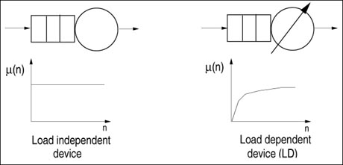
Figure 14.1. Service rate function for LI and LD devices.

Slide 7
Chapter’s Path
In this chapter the MVA method [16] is extended to handle the existence of load-dependent (LD) devices.
An example is presented, followed by
single and multiple class LD solution algorithms.
Closed and open models are allowed.
At the end of the chapter, the Flow Equivalent Server Method is introduced.

Slide 8
Chapter 14-Outlines
14.1 Introduction
14.2 Motivating Example
14.3 Single Class Models with LD Devices
14.4 Multiclass Closed Models with LD Devices
14.5 Multiclass Open Models with LD Devices
14.6 Flow-Equivalent Server Method
14.7 Concluding Remarks
14.8 Exercises
Bibliography

Slide 9
Motivating Example
In the classic client-server (CS) computing paradigm, one or more clients and one or more servers, along with the underlying operating system, interprocess communication system, and network protocols, form a composite system allowing distributed computation [1, 18].
A client is defined as a requester of services and a server as the provider of services.
Servers control access to shared resources, such as file systems, databases, gateways to WANs, and mail systems.

Slide 10
Motivating Example
Remote Procedure Calls(RPCs) or structured query language(SQL) statements are typically used by clients to request services from servers in a client-server system.
Figure 14.2 shows a request generated at the client and serviced by the server.
For instance, a file service request ("read block x from file y") is invoked at the client as an RPC. The RPC obtains service from a file server and returns the result, via the network, to the calling client. Several network messages may be necessary to send the result from the server to the client.

Slide 11
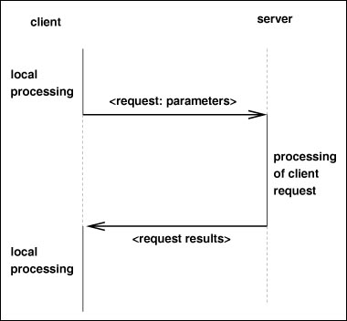
Figure 14.2. Client-server interaction.

Slide 12
14.2.1 Client-Server Performance
Several factors influence the performance of a client-server application. One of them is the network latency. As depicted in Figure 14.3, the response time of a transaction in a CS system can be decomposed as
Equation 14.2.1 :
The client delay includes processor time plus any disk time at the client workstation.

Slide 13
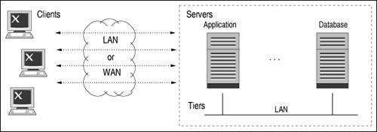
Figure 14.3. Client-server architecture.
The client processor time accounts for the time necessary to execute the user interface code, local preparation of the service request at the application level and the time necessary to process all protocol levels from the session layer down to the transport/network layer (e.g., TCP/IP [10]).

Slide 14
14.2.1 Client-Server Performance
Usually, client workstations have local disks, for operating system purposes, to hold temporary files, and to cache files in order to reduce traffic with the server.
The delay at the client is independent of the total system load and consists only of the service demands at the client.
The network delay is composed of
1) the time necessary to get access to the network through the appropriate MAC.
2) the time necessary to transmit the service request packets through the network.

Slide 15
14.2.1 Client-Server Performance
Network access time depends on the network load. This activity is appropriately modeled using a load-dependent server.
Server delay is decomposed into server processor time plus disk service time. Queues may form at these devices since the server is a shared resource.
The service demands at the server disks depend on the type of service provided by the server.
The performance of CS systems is greatly influenced by the congestion levels at the shared resources (network, server processor, and server disks).

Slide 16
14.2.2 Design Questions for a CS Application
Consider a company that is designing a data center to process credit inquiries. Good performance (response time) is a necessity for the company to attract customers.
The company is planning an architecture that scales to serve thousands of requests without sacrificing performance. The data center has other QoS goals, such as 24x7 operation, 99% availability, and high reliability.
The center consists of a CS system with a relational database.

Slide 17
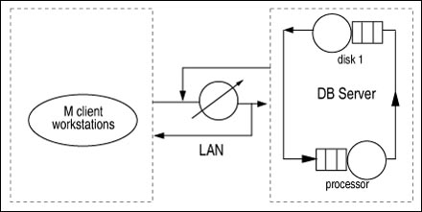
14.2.2 Design Questions for a CS Application
Clients generate financial requests to the database via a 100 Mbps LAN network.Each financial request generates SQL requests to the database.
The queuing model that represents the CS system is depicted in Figure 14.4.

Slide 18
14.2.2 Design Questions for a CS Application
For the sake of simplicity, assume that all financial requests have similar resource demands and can be characterized by a single class.
The client workstations are represented by a single delay device with service demand equal to D^{cl}. This represents the time a client spends before submitting the next request to the server (Think time).
The LAN is modeled by a load-dependent device and the database server by two load independent devices.

Slide 19
14.2.2 Design Questions for a CS Application
Typical design questions that could be answered with the help of a performance model are:
How does the speed of the DB processor influence response times and throughput?
What is the effect of adding more client workstations to the CS system?
What is the performance impact of using a faster network to connect clients to servers?
What is the impact of increasing the level of security of the system through new and stronger authorization mechanisms in the database access or in user authentication procedures?

Slide 20
14.2.3 System and Workload Specification
After building a prototype for the new application, service demands are measured for the various devices.
Consider the following SQL request-related parameters:
N_{sql}: average number of SQL requests per financial transaction.
L_{sql}: average size, in bytes, of the result of an SQL request.
D^{cl}: average time elapsed at the client workstation from when a reply to a previous SQL command is received and a new one is issued.
: average processor service demand per SQL request at the database server.
: average disk service demand per SQL request at the database server

Slide 21
14.2.3 System and Workload Specification
Consider the following network-related parameters:
B: network bandwidth in bits per second (bps).
S: slot duration (i.e., the round-trip propagation time of the channel, which is also the time required for a collision to be detected by all stations).
L_{p}: maximum packet length, in bytes, including header and payload.
: average packet length, in bytes.
L_{d}: maximum length, in bytes, of the payload of a packet.

Slide 22

14.2.3 System and Workload Specification
The average number of packets, NP_{sql}, generated per SQL request can be computed as follows.
Assume that the request from the client to the server consists of a single packet. The number of packets necessary to send the result from the server to the client is given by [L_{sql}/L_{d}]. Thus,
Table 14.1 shows the values of all measured and computed parameters for the CS model.

Slide 23
Table 14.1. Parameters for the CS Financial Application
SQL-request-related parameters
Nsql 4 SQL commands/request Lsql 10,000 bytes Dcl 0.1 sec 0.12 sec 0.005 sec
Network Parameters
B 100 Mbps S 51.2 msec Lp 1,518 bytes 1,518 bytes Ld 1,492 bytes
Computed Parameter
NPsql 8 Packets

Slide 24
14.2.3 System and Workload Specification
Queuing devices represent the processor and disk at the DB server. The service time per packet at the network is dependent on the number of workstations contending for it.
As shown in Figure 14.4, the LAN is represented by a load-dependent device to indicate that, as the load on the network increases, the throughput on the LAN decreases due to the additional number of collisions experienced on the network medium.

Slide 25
Chapter 14-Outlines
14.1 Introduction
14.2 Motivating Example
14.3 Single Class Models with LD Devices
14.4 Multiclass Closed Models with LD Devices
14.5 Multiclass Open Models with LD Devices
14.6 Flow-Equivalent Server Method
14.7 Concluding Remarks
14.8 Exercises
Bibliography

Slide 26


Single Class Models with LD Devices
Chapter 12 presents the three main relationships (repeated below) needed to solve a queuing network using MVA. They assume that service times are LI.
Equation 14.3.2 :
Equation 14.3.3 :
Equation 14.3.4 :

Slide 27
Single Class Models with LD Devices
For load-dependent (LD) devices, the service rate, and consequently the response time, is a function of the distribution of customers at the device.
Therefore, Eqs. (14.3.2) and (14.3.4) need to be adjusted. Instead of simply the mean queue length, the complete queue length distribution at these devices is required. Let :
P_{i}(j | n) = probability that device i has j customers given, that there are n customers in the QN.
μ_{i}(j) = service rate of device i when there are j customers at the device.

Slide 28
Single Class Models with LD Devices
An arriving customer who finds j – 1 customers at device i will have a response time equal to j/μ_{i}(j).
The probability that an arrival finds j – 1 customers at device i given that there are n customers in the queuing network is P_{i}(j – 1 | n – 1), due to the Arrival Theorem [19].
The average residence time is computed as the product of the average number of visits to the device times the average response time per visit. That is,

Slide 29
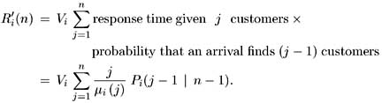

Single Class Models with LD Devices
Equation 14.3.5 :
The mean queue length at node i is given by
Equation 14.3.6 :
What remains is the computation of P_{i}(j | n) . By definition, P_{i}(0 | 0) = 1.

Slide 30

Single Class Models with LD Devices
Applying flow equilibrium to the queuing network states [9], the probability of having j customers at device i for a queuing network with n customers can be expressed in terms of the probability of having j – 1 customers at device i when there is one less customer in the queuing network. Hence,
Equation 14.3.7 :
where αi(j) is a service-rate multiplier [12] defined as μ_{i}(j) /μ_{i}(1) . From Eq. (14.3.5) and the definition of the service-rate multipliers it follows that

Slide 31


Single Class Models with LD Devices
Equation 14.3.8 :
The service time,S_{i}, when there is no congestion at device i is 1/μ_{i}(1). Since D_{i} = V_{i}S_{i}, it follows that
Equation 14.3.9 :
The MVA algorithm for load-dependent devices is given in Figure 14.5.

Slide 32
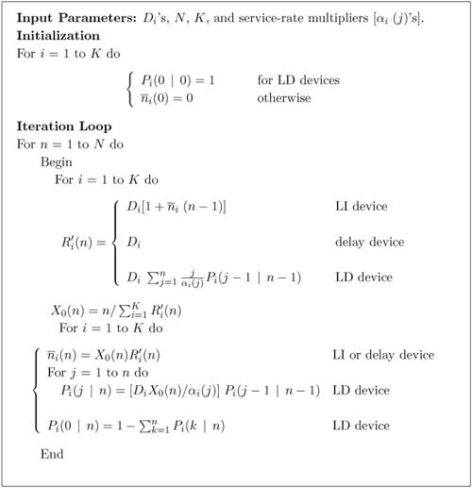
Figure 14.5. Exact single-class MVA algorithm with LD devices.

Slide 33

Example 14.1.
A Web server has two processors and one disk. Benchmarks indicate that a two-processor server is 1.8 times faster than the single-processor model for this type of workload. Thus,
Let the service demand of an HTTP request at the disk and processor be 0.06 sec and 0.1 sec, respectively. For simplicity, let the maximum number of simultaneous connections be 3. Using the algorithm of Figure 14.5 yields the results shown in Table 14.2.

Slide 34
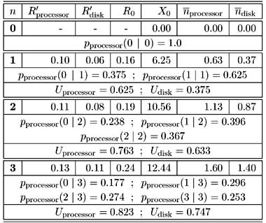
Table 14.2. Detailed Results of the Load Dependent MVA
The table also shows conditional probabilities at the load-dependent device that models the 2-processor system.

Slide 35
Example 14.2.
Consider the financial application described in the motivating example. We want to calculate the database server throughput and response time.
The CS system has 100 workstations. However during any given period of time only an average of 30% of the workstations are active(30 workstations).
First, an expression is required for the service rate of the network as a function of the number of client workstations using the network.
Let μ_{net}(m) denote the LAN service rate measured in SQL requests per second as a function of the number of client workstations m.

Slide 36

Example 14.2.
Equation 14.3.10 :
where μ_{p}(n) is the network throughput,in packets/sec, for a network with n stations.
Note that when m = 1, even though there are 2 stations in the network (the server and 1 client), the server transmits only when requested by the client. No collisions occur.
For that reason, μ_{p}(1) is used in the expression for μ_{net}(1) .

Slide 37

Example 14.2.
An expression for μ_{p}(n) for an Ethernet network is derived in [12] and is given by
Equation 14.3.11 :
where C is the average number of collisions and is given by (1 – A)/A. The parameter A is the probability of a successful transmission and is given by (1 – 1/n)^{n–1}.
Using the parameters in Table 14.1, one can obtain the values of the throughput μ_{net}(m) when there are m client workstations.

Slide 38
Example 14.2.
Using these values for μ_{net}(m),for m = 1,2,...30, the MVA model with LD devices given in Figure 14.5 yields a throughput of 82.17 SQL requests/sec and a response time equal to 0.265 sec.
The network time is equal to 0.00095 sec, which represents only 0.36% of the total response time.
In this case, the LAN can be effectively ignored since the network speed of 100 Mbps is such that collisions and packet transmission times become negligible.

Slide 39

Example 14.3.
Consider a database server with 8 processors and 2 disks. The 8 processors allow the server to run concurrent server processes.
Using an OLTP benchmark provides the following scaling factor function over a 1-processor configuration:
The system is used for processor intensive transactions,needing an 8-processor server. Let the service demand of a transaction at the 2 disk subsystems be 0.008 and 0.011 sec, respectively. The processor service demand is 0.033 sec.

Slide 40
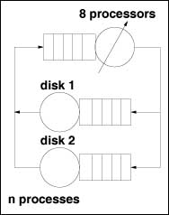
Example 14.3.
What is the impact of increasing the number of concurrent processes at the multiprocessor database server?
The database server is represented by a model, composed of the 3 devices.Two LI disk subsystems and a LD device that models the 8-processor server, as shown in Figure 14.6.
Figure 14.6.
Multiprocessor database server model.

Slide 41
Example 14.3.
Consider two scenarios: in the first case, the system executes 20 processes simultaneously and in the second case, the database runs 30 processes concurrently. The results obtained with the algorithm of Figure 14.5 are shown in Table 14.3.
Table 14.3. Results for Example 14.3
The model's results indicate that 8 processors are capable of handling the processor intensive transactions (U_{processor} < 40%) However, disk2 is the bottleneck (U_{disk2} > 95%) of the database server and limits the system throughput.
N | R'processor | R'disk1 | R'disk2 | R0 | X0 | Uprocessor | Udisk1 | Udisk2
20 | 0.067 | 0.024 | 0.135 | 0.227 | 87.96 | 36.28 | 70.36 | 96.75
30 | 0.069 | 0.026 | 0.239 | 0.334 | 89.73 | 37.01 | 71.78 | 98.70

Slide 42
Chapter 14-Outlines
14.1 Introduction
14.2 Motivating Example
14.3 Single Class Models with LD Devices
14.4 Multiclass Closed Models with LD Devices
14.5 Multiclass Open Models with LD Devices
14.6 Flow-Equivalent Server Method
14.7 Concluding Remarks
14.8 Exercises
Bibliography

Slide 43
Multiclass Closed Models with LD Devices
The algorithm for solving a multiple-class closed QN with load-dependent devices is an extension of the approximate algorithm for multiple classes given in Chapter 13.
It is assumed that the service-rate multiplier of any load-dependent device is class independent (i.e., if device i is load-dependent, then a_{i,r}(j) = a_{i}(j) for all classes r).
The basis for the algorithm lies in obtaining an expression for the marginal probability, ,of finding j customers at load-dependent device i given that the QN population vector is .

Slide 44
Multiclass Closed Models with LD Devices
This probability can be obtained from the local balance equations of the network states [9] as
Equation 14.4.12:
Where is the total number of customers in the network.
As in the load-independent case, the dependency on values derived by removing one customer from each class makes an exact MVA solution for even moderate size QNs very expensive.

Slide 45
Multiclass Closed Models with LD Devices
To overcome this problem, we approximate that
Equation 14.4.13 :
In other words, it is assumed that the removal from the QN of one customer of class r does not significantly affect the overall queue length distribution at device i [9].
Using Eq. (14.4.13) in Eq. (14.4.12) and the fact that
, it follows that

Slide 46
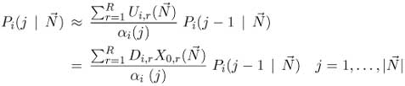

Multiclass Closed Models with LD Devices
Equation 14.4.14 :
Solving Eq. (14.4.14) recursively one can obtain a closed-form expression for as a function
of can be obtained by requiring all probabilities to sum to 1 (see Exercise 14.5). Thus,
Equation 14.4.15 :

Slide 47



Multiclass Closed Models with LD Devices
Equation 14.4.16 :
The generalization of Eq. (14.3.9) for the multiple-class case is
Equation 14.4.17 :
Using the approximation given in Eq. (14.4.13) in Eq. (14.4.17), it follows that
Equation 14.4.18 :

Slide 48
Multiclass Closed Models with LD Devices
The values of the probabilities P_{i}(j – 1 | ) are needed to compute the residence time .
To compute these probabilities the values of the throughputs X_{0,r}( ) are needed, which depend back on the residence time values. The following iterative approach is proposed:
1. Estimate initial values for the throughputs X_{0,r}( ), that can be obtained by approximating the throughput by its asymptotic upper bound, namely
.
2. Using Eqs. (14.4.15) and (14.4.16), compute the probabilities P_{i}(j | ).

Slide 49

Multiclass Closed Models with LD Devices
3. Compute the residence times using Eq. (14.4.18).
4. Compute new values for the throughputs using Little's result as
5. If the relative error between the throughputs obtained in the current iteration and the previous iteration is greater than a certain tolerance then go to step 2. Otherwise, compute the final metrics and stop.
This approach is specified in detail in the algorithm of Figure 14.7. The notation K_{r} indicates the number of devices for which D_{i,r} > 0 .

Slide 50
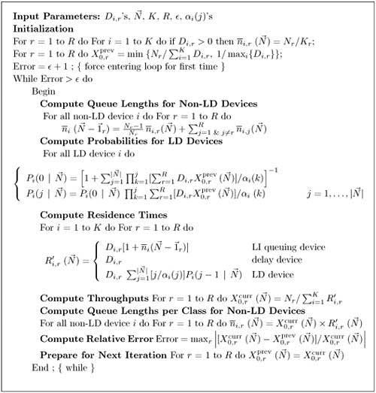
Figure 14.7. Approximate multiclass MVA algorithm with LD devices.

Slide 51
Example 14.4.
Consider the client-server architecture shown in Figure 14.3.
The application layer is designed to support up to 80 simultaneous processes. Each application process receives a client request, executes the application logic, and interacts with the database server.
There are 3 type of processes (in terms of resource usage).
the application had 35 processes running on average.
What is the average database response time?
The analyst decides to use a 3-class closed model with an LD device to represent the two-tier architecture depicted in Figure 14.8.

Slide 52
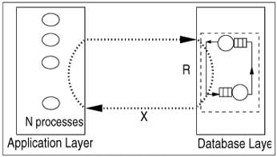
Example 14.4.
Figure 14.8. Performance model of a two-tier client-server architecture.
The database server have 1 processor and 1 disk.
There are 3 types of requestrs : trivial, average,and complex, according to their use of database resources.

Slide 53
Example 14.4.
For submitting these types of requests, 10, 20, and 5 application processes are responsible,respectively.
By measuring the application processes, the behavior of processes is parameterized & summarized in Table 14.4.
Table 14.4. Parameterization Data for the Example of Multiclass Load-Dependent MVA
Req. Type | % of Req. | Think time sec | Avg. No. Packets/Req. | Avg. Packet Length per Req. (bits) | Disk Demand (msec) | Processor Demand (msec)
Trivial | 16.4 | 0.1 | 2 | 800 | 8 | 1.6
Average | 63.9 | 0.2 | 3 | 1382 | 14 | 10.1
Complex | 19.3 | 0.4 | 9 | 1410 | 25 | 16.8

Slide 54
Example 14.4.
For random data access as in this example, the Disk service demand could be determined by multiplying the number of I/Os issued by a process by the average disk access time.
When estimating service demands from measurement data,all the features of the disk architecture are captured by the measuring process.
The disk demands reported in Table 14.4 reflect this measurement data.
The LAN is assumed to be a 10-Mbps Ethernet with a slot duration S of 51.2 msec.

Slide 55
Example 14.4.
The average network service demands per transaction class can be computed as : the average number of packets x the average packet length divided by the network bandwidth.
This gives values 0.16, 0.41, and 1.27 msec for trivial, average, and complex requests, respectively.
The network is modeled as a load-dependent device with a class independent service rate function μ(n) .
To use Eq. (14.3.11) for the Ethernet throughput, the average packet length over all classes is computed from the data in Table 14.4 as follows:

Slide 56
Example 14.4.
The average number of packets per request, P_{req} , is given by
The service rate in requests/sec for the network is equal to its service rate in packets/sec divided by the average number of packets per transaction.
The algorithm of Fig 14.7 yields the performance metrics shown in Table 14.5.
In this particular example, convergence is achieved after 16 iterations for a tolerance of 10^{–4}.

Slide 57
Table 14.5. Metrics for Example of Multiclass Load-Dependent MVA
 | Residence Time (sec)
Req. Type | Network | Processor | Disk | Response Time (sec) | Throughput (req/s)
Trivial | 0.00017 | 0.0034 | 0.164 | 0.167 | 37.34
Average | 0.00044 | 0.0213 | 0.288 | 0.310 | 39.23
Complex | 0.00134 | 0.0355 | 0.515 | 0.552 | 5.25

Slide 58
Chapter 14-Outlines
14.1 Introduction
14.2 Motivating Example
14.3 Single Class Models with LD Devices
14.4 Multiclass Closed Models with LD Devices
14.5 Multiclass Open Models with LD Devices
14.6 Flow-Equivalent Server Method
14.7 Concluding Remarks
14.8 Exercises
Bibliography

Slide 59
Multiclass Open Models with LD Devices
The algorithm presented in this section is an extension of the algorithm presented in Chapter 13 for solving multiple-class open queuing networks.
Similar to the closed queuing network case, it is assumed that the service rate-multiplier of any load-dependent device is class independent (if device i is load-dependent,then a_{i,r}(j) = a_{i}(j) for all classes r).
As discussed in Chapter 13, the solution to an open queuing network exists only if the stability condition is satisfied.

Slide 60

Multiclass Open Models with LD Devices
In the case of load-dependent multiclass open networks with class-independent service multipliers, the stability condition is
Equation 14.5.19 :
If device i is load-independent, a_{i}(j) = 1 for all j and the stability condition reduces to i : Ui < 1, as shown in Chapter 13.
Let be the vector (λ₁, ···, λ_{R}) of arrival rates per class. Let P_{i}(j| ) be the probability that there are j customers, irrespective of their classes, at device i given that the arrival rate vector is .

Slide 61

Multiclass Open Models with LD Devices
The residence time, , of a class r customer at device i is given by
Equation 14.5.20 :
where R_{i,r}( ) is the average response time per visit to device i of a class r customer. This can be computed from Little's result as
Equation 14.5.21 :
where is the average number of class r jobs at device i and λ_{i,r} is the average arrival rate of class r jobs at device i.
Equation 14.5.22 :

Slide 62


Multiclass Open Models with LD Devices
where is the average total number of customers at device i. can be computed from the device probabilities as
Equation 14.5.23 :
The probability distribution of node i is given by [9]:
Equation 14.5.24 :
where β(j) = α(1) x ... x α(j) . The probability P_{i}(0| ) results from requiring that all probabilities sum to 1. Thus,

Slide 63


Multiclass Open Models with LD Devices
Equation 14.5.25 :
Assuming that the service-rate multipliers become constant after some value w_{i}, as in most practical cases, closed-form expressions are obtained for the probabilities P_{i}(j | ) and for .
The stability condition in this case becomes
i : U_{i}/α_{i}(w_{i}) < 1. Assuming that α_{i}(j) = α_{i}(w_{i}) for j w_{i} (see Exercise 14.7):
Equation 14.5.26 :

Slide 64


Multiclass Open Models with LD Devices
Equation 14.5.27 :
and
Equation 14.5.28 :
The Service Demand Law implies that U_{i,r} = λ_{r}D_{i,r}
and in the above equations.

Slide 65
Multiclass Open Models with LD Devices
The result is an algorithm to solve multiclass open queuing networks with load-dependent servers as a function of the class service demands and the class arrival rates.
Figure 14.9 displays this algorithm. R_{0,r}( ) denotes the average system response time of class r customers and denotes the average number of class r customers in the system.

Slide 66
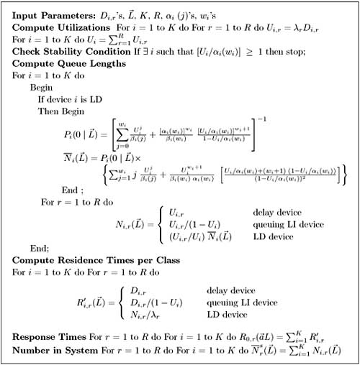
Figure 14.9. Exact multiclass open QN algorithm with LD devices.

Slide 67
Example 14.5.
Peer-to-peer(P2P) applications have been used mainly for sharing video, audio files and software.
In contrast to client-server applications, a peer is both a requester and provider of services.
P2P architectures can be classified into 3 basic categories:
centralized service location (Napster)
distributed service location with flooding (Gnutella)
distributed service location with hashing (Chord, CAN, Pastry, Tapestry) [7]
Unlike CS computing, peers generate workloads (requests for downloading files), but also provide the capacity to process workloads.

Slide 68
Example 14.5.
Consider a hypothetical P2P file sharing system, composed of a large number of peers. The system has a centralized service location architecture.
To locate a file, a peer sends a query to the central server, which performs a directory lookup and identifies the peers where the files are located.
Once the desired file has been located, a peer-to-peer interaction is established to download the file.
Assume that the system receives λ requests/sec, where a request consists of downloading a file.
A QN model is used here to calculate the average time to download a file.

Slide 69
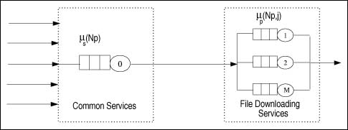
Example 14.5.
This example presents a simple performance model of a P2P file sharing application based on the modeling technique proposed in [7].
After going through the central server, all requests to download a specific file are required to join the queue associated with the file to be served, as shown in Figure 14.10.
Figure 14.10.

Slide 70
Example 14.5.
The service rate of the server that represents a given file varies with
1) the number of replicas of the file in P2P application
2) the popularity of that particular file
3) the total load of the system
Thus, the overall queuing model consists of a load-independent server representing the common service component (the central server) and a set of
load-dependent servers, representing the files in the system.

Slide 71

Example 14.5.
The response time of a request is a combination of two factors:
Equation 14.5.29 :
The common service rate (the file location service) is independent of the number of peers and is given by:
Equation 14.5.30 :
where N_{p} denotes the number of active peers in the system.

Slide 72

Example 14.5.
Zipf's Law[21] can be used to characterize the access frequency to Internet objects.
When one ranks the popularity of events, Zipf's Law states that the size y of the r_{th} largest occurrence of the event is inversely proportional to its rank.
This means that y ~ rα. It can be shown that
Equation 14.5.31 :
where p_{j} is the probability associated with event j, K is a constant and α is the scaling parameter of the distribution.

Slide 73
Example 14.5.
The data shown in [2] indicates that Zipf's Law applies to files serviced by Web servers.
This means that the n-th most popular document is exactly twice as likely to be accessed as the 2n-th most popular document, when α = 1, regardless of K.
The service rate for a given file in the system is directly proportional to the number of replicas of that file and to the load of the system (the number of active peers) [7].
The number of replicas is assumed to be proportional to the popularity of files.

Slide 74

Example 14.5.
Thus, Zipf's Law is used to model the number of replicas providing an estimated download service rate given by:
Equation 14.5.32 :
where H represents the service rate brought to the system by a single peer (its contribution to the system's capacity).
Consider a small system with 3 types of files: software, music, and video. A collection of peers generates the 3 types of requests to the system.

Slide 75
Example 14.5.
Assume that the P2P system has 30 peers connected by links of 200 Kbps.
Let H be 1 download/sec, corresponding to the time needed to download a 0.2 Mb file, using a 200 Kbps link.
Assume that all files are equally popular, implying no file replicas and that K/jª = 1.
Thus, using Eq. (14.5.32) it follows that the file download rate is μ_{f}(N_{p}) = N_{p} x H = N_{p} downloads/sec.
However, as has been observed [8], there are 2 types of peers, freeloaders and non-freeloaders.

Slide 76

Example 14.5.
Freeloaders are those peers that only download files for themselves without providing files to be further downloaded by others.
Thus, using this type of evidence, it is assumed that only 10% of the peers (i.e., 3) contribute to the total capacity of the system.
This indicates that the service rate multiplier for the file download queue is given by:
Table 14.6 shows the estimated data for each type of request at the central server.

Slide 77
Example 14.5.
Request Type | Avg. Arrival Rate (req./sec) | Mean File Size (Mb) | Server Demands (sec)
 |  |  | Processor | Disk
Software | 1.0 | 0.18 | 0.005 | 0.015
Music | 0.6 | 0.30 | 0.015 | 0.012
Video | 0.4 | 0.48 | 0.010 | 0.008
Table 14.6. Parameterization Data for Example 14.5
The average file download times, using the algorithm in Figure 14.9, are 4.12 sec, 6.85 sec, and 10.94 sec, respectively, for software, music, and video files. The average queue length of the load-dependent device is 12.56 requests.

Slide 78
Chapter 14-Outlines
14.1 Introduction
14.2 Motivating Example
14.3 Single Class Models with LD Devices
14.4 Multiclass Closed Models with LD Devices
14.5 Multiclass Open Models with LD Devices
14.6 Flow-Equivalent Server Method
14.7 Concluding Remarks
14.8 Exercises
Bibliography

Slide 79
Flow-Equivalent Server Method
Divide and conquer is a common approach to solving problems in computing. It also applies to solving queuing models.
It is often efficient to solve a queuing network by partitioning it into several smaller subnetworks and then combining the solutions of the subnetworks into an approximate solution for the entire network.
This approach is referred as decomposition and aggregation.
The basic idea is to replace each subnetwork of queues by a single load-dependent queue, which is “flow-equivalent” to the subnetwork.

Slide 80
Flow-Equivalent Server Method
For repeated evaluations, the solution of a FES model requires less computation than the original one.
This technique is useful in modeling large systems because it allows large queuing networks to be decomposed and reduced to a series of smaller queuing models.
Consider a closed queuing network model composed of a number of queues and a total population size of N. The FES algorithm consists of the following sequence of steps [3, 5, 12] :

Slide 81
Flow-Equivalent Server Method
Select a queue or a set of queues, that form the subnetwork β, that will be analyzed in detail.
Construct a reduced network by replacing subnetwork β by a "short" (i.e., set the service time of all the servers of the subnetwork β to 0).
Solve the reduced network using the MVA algorithm. Determine the throughput of the network when there are n customers in the network,n = 0,1,2,...N .
Replace the reduced network by a load-dependent "Flow Equivalent Server(FES)" whose load-dependent service rate, μ_{(n)} , is equal to the throughput of the shorted network with n customers, n = 0,1,2,...N .

Slide 82
Flow-Equivalent Server Method
The network formed by subnetwork β and the FES is equivalent to the original network.The equivalent network is solved using MVA techniques with load-dependent servers.
When the flow-equivalent method is applied to closed single-class product-form models, it yields exact results [3].
In non-product form cases, some error is introduced.
Courtois [6] has shown that relatively small errors are introduced with this approximation if the rate at which transitions occur within the subnetwork is much greater than the rate at which the subnetwork interacts with the rest of the network.

Slide 83
Example 14.6.
Consider the queuing network model of Fig. 14.11(a), representing a server, disks, and with multiple custmomer threads. The system is composed of 1 processor and 3 disks.
When a thread is executing and issues an I/O request it gets blocked until the request is satisfied.
Assume that the server operates with 3 threads. The model parameters are:
S₀ = 2/15 sec, V₀ = 3,D₀ = 0.4 sec, S₁ = S₂ = S₃ = 1 sec, V₁ = V₂ = V₃ = 1, D₁ = D₂ = D₃ = 1 sec, and n = 3.
The purpose of this example is to analyze the queuing model using the FES method.

Slide 84
Example 14.6.
The original network is shown in Fig. 14.11(a).
The subnetwork β in this example consists of the processor.
Step 2 sets the processor time to 0 and creates a reduced network composed of 3 disks as indicated in Fig. 14.11(b). This reduced network is solved for each thread population value (n = 1,2,3).
The MVA algorithm calculates the throughput of the disk subsystem: X(1) = 0.333 requests/sec, X(2) = 0.5 requests/sec, and X(3) = 0.6 requests/sec.
The disk subnetwork is then replaced by a load-dependent FES with the mean service rates equal to X(1),X(2),X(3) .

Slide 85
Example 14.6.
The original system is then reduced to a network composed of the processor and the load-dependent FES server, as illustrated in Fig. 14.11(c).
Since the original model has a product-form solution, the results calculated for the flow-equivalent model exactly match those of the original model.
By using the load-independent MVA algorithm on the model of Fig. 14.11(a) and the load-dependent MVA algorithm on the model of Fig. 14.11(c), the same results for throughput and response time, namely 0.569 threads/sec and 5.276 sec, respectively, are obtained.

Slide 86
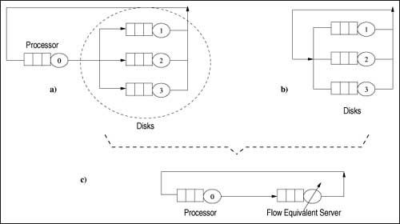
Example 14.6.
Figure 14.11. Flow-equivalent technique.

Slide 87
Chapter 14-Outlines
14.1 Introduction
14.2 Motivating Example
14.3 Single Class Models with LD Devices
14.4 Multiclass Closed Models with LD Devices
14.5 Multiclass Open Models with LD Devices
14.6 Flow-Equivalent Server Method
14.7 Concluding Remarks
14.8 Exercises
Bibliography

Slide 88
Concluding Remarks
The techniques discussed in previous chapters are extended here to allow one to analyze the performance of queuing models with load-dependent devices. Exact algorithms are presented for single class closed QNs with load-dependent servers and for single and multiple class open QNs with load-dependent servers. An approximate algorithm for multiple-class closed QNs is also given. The chapter also introduces a method for analyzing queuing models, called Flow Equivalent Server Method, which is the basis for solution techniques for non product-form queuing models, covered in the next chapter.

